Slide 1


Model – Free Adaptive Control
AY 2021-25
GITAM UNIVERSITY
Major Project
Project ID: C4
A University should be a place of light, of liberty, and of learning.
Department of Electrical Electronics and Communication Engineering
Project Mentor:
K . George
Project Team:-
P . Irfan – BU21EECE0100500
Y . V . Yaswanth – BU21EECE0100450
P . Hidayatullah – BU21EECE0100390
www.gitamedu.com

Slide 2




Project Group – Details
Photo
Track
Roll No
Name
EECE
BU21EECE0100500
P . Irfan
EECE
BU21EECE0100450
Y . V . Yaswanth
EECE
BU21EECE0100390
P . Hidayathullah

Slide 3
Objective and Goals
Objective
Robustness : Ensure the control system can handle uncertainties and variations in system dynamics.
Adaptability : Enable the control system to learn and adjust in real time to changing conditions.
Performance Optimization : Achieve desired performance metrics( like stability, speed of response) without needing a detailed model.
Goals
Real time Learning : Develop algorithms that can update control strategies based on observed system behavior in real time.
Stability Assurance : Maintain system stability even as parameters change or new disturbances.
Scalabiity : Ensure the control strategy can be applied to a wide range of systems and applications without extensive redesign

Slide 4
Abstract
The design of control systems has evolved over the past one hundred years. The early years was called the classical design era wherein the focus was on single-input single-output (SISO) linear time-invariant (LTI) systems and examples of compensators include P, PI, PD, PID, lead and lag controllers. The introduction of state-space led to the modern control era and predominant design is the linear quadratic regulator, an optimized with respect to the energy in the states and control energy. The drawbacks led to the robust control design method. All of these design methodologies require a basic model of the plant or dynamical system.
Motivated by nature’s ability to adapt to changing environments, researchers began to work in the 1950s on controllers that could adapt to changing environment, parametric changes and process disturbance. It was not until the 1980s the proof of stability of an adaptive system for SISO LTI systems. These are called model-reference adaptive controllers (MRAC). Even though the precise model was not required, a structure of the model is needed to ensure that all signals in the controlled system are bounded and the tracking error reduce to zero asymptotically. In indirect MRAC, the unknown parameters of the model-structure are estimated at every instant of time and the estimated model is used to control the plant. Over the past two decades a new paradigm began to emerge, that of model-free controllers. These are often referred to as data-driven controllers. The stated advantage of this method is that a model of the plant is not required. In contrast to this only the input-output data is required. A number of model-free techniques have been proposed in the literature. This aim of this project is to analyse one such method and to study its efficacy. Specifically, the compact for dynamic linearization method is used to control the outputs of a tower crane. The linearization is carried out using so-called pseudo-partial derivatives. Since the linearization is dynamic, the controller is adaptive in nature. The controller is tuned based on the input-output data. Accordingly, this is also known as model-free adaptive controller.

Slide 5
Analysis - SWOT
Weaknesses
Strengths
performance limitations
Data Dependency
convergence Issues
Robustness to Uncertainity
Real time Adaptation
simplicity
Threats
Competition from model control
Complex System Behavior
Opportunities
Emerging Technologies
Intergration with machine learning
Increased Demand for Automation

Slide 6
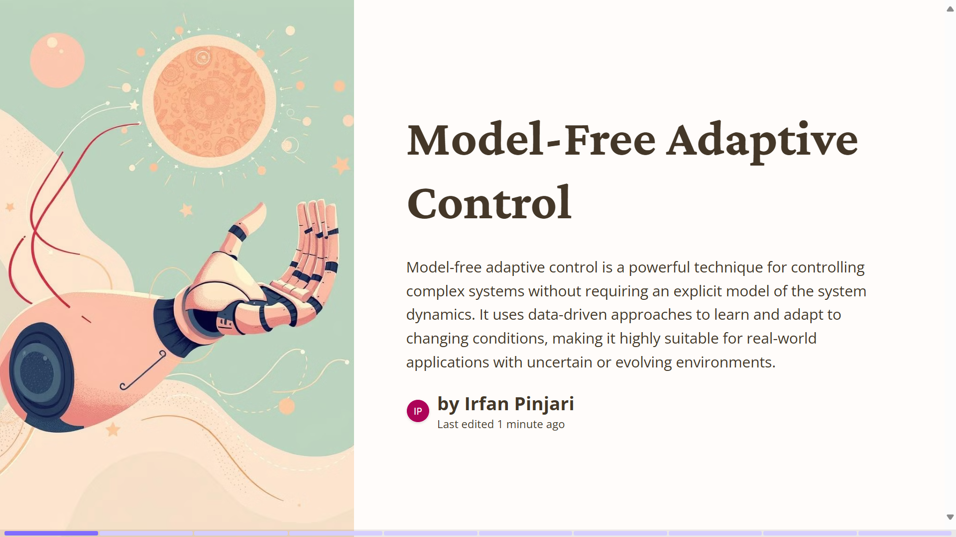

Slide 7
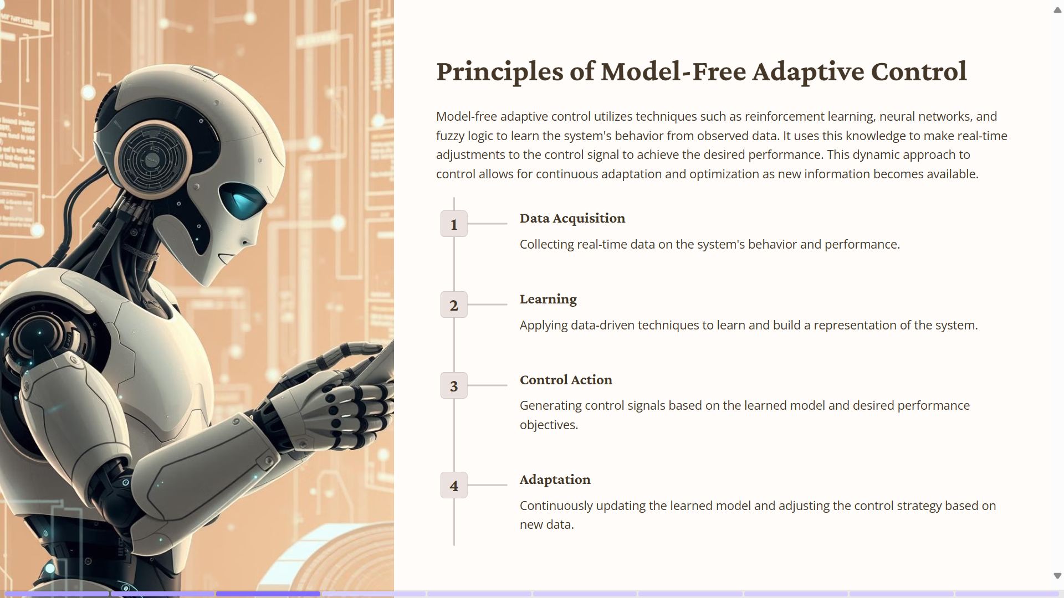

Slide 8
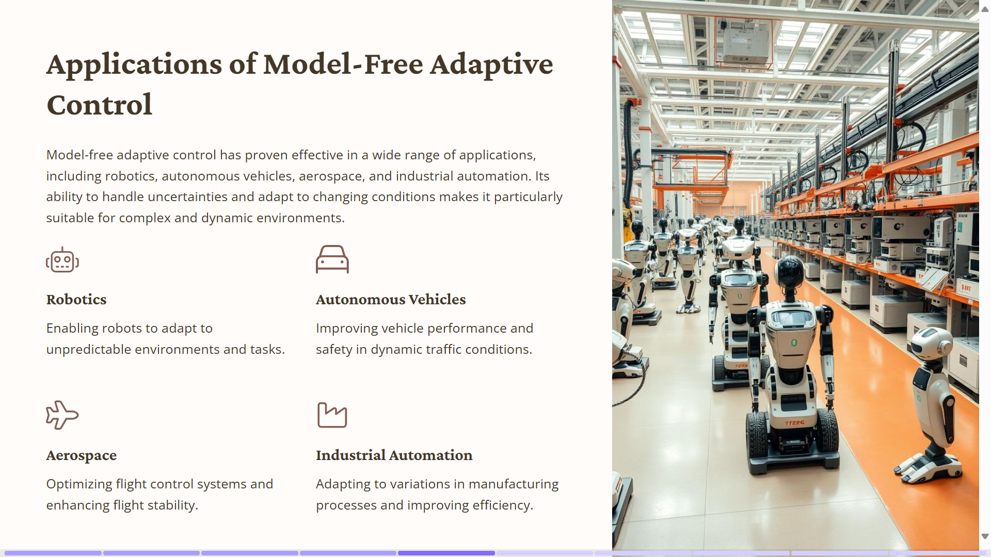

Slide 9
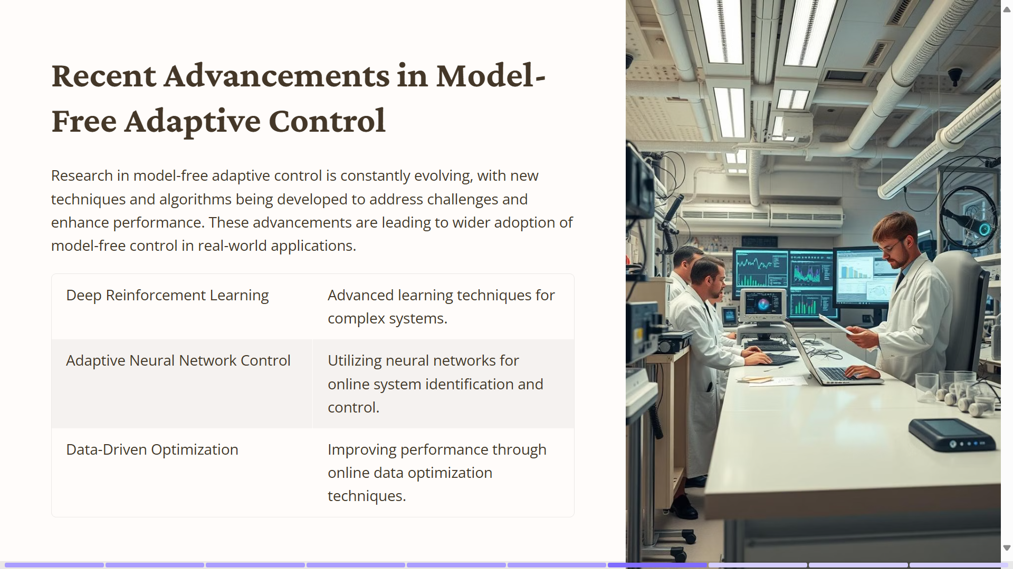

Slide 10
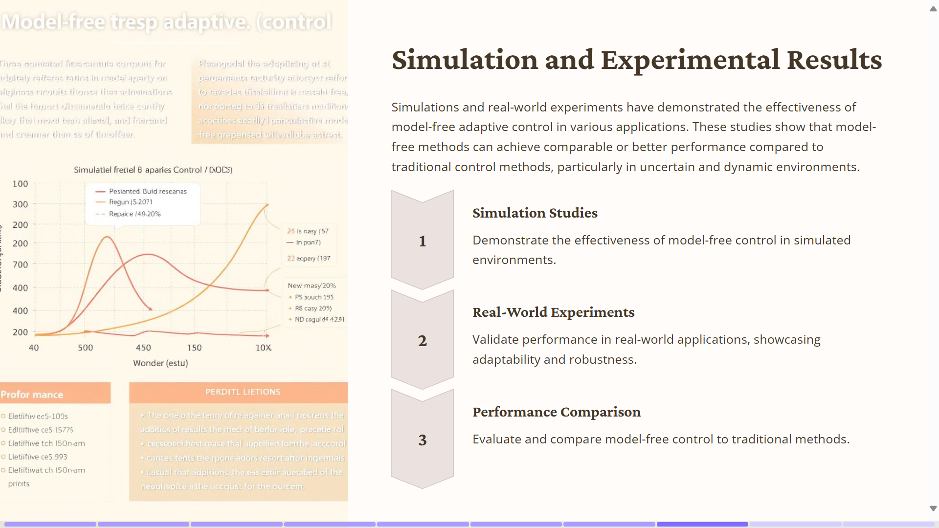

Slide 11
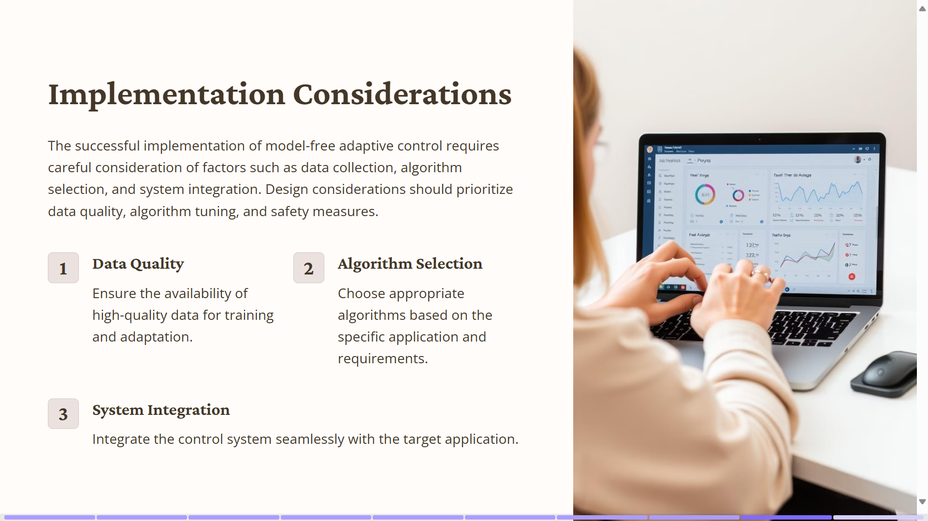

Slide 12
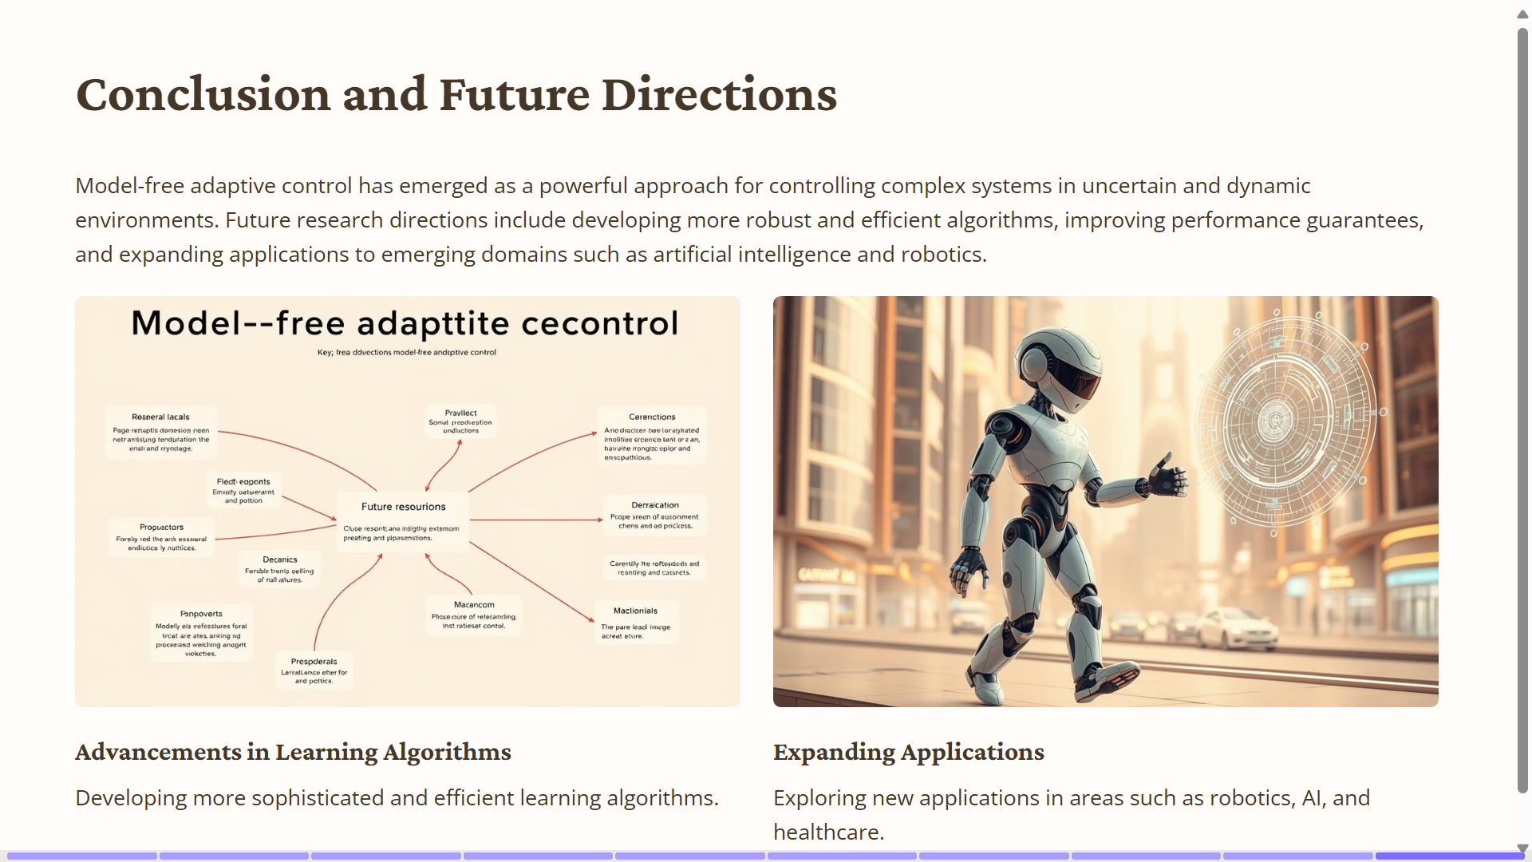

Slide 13
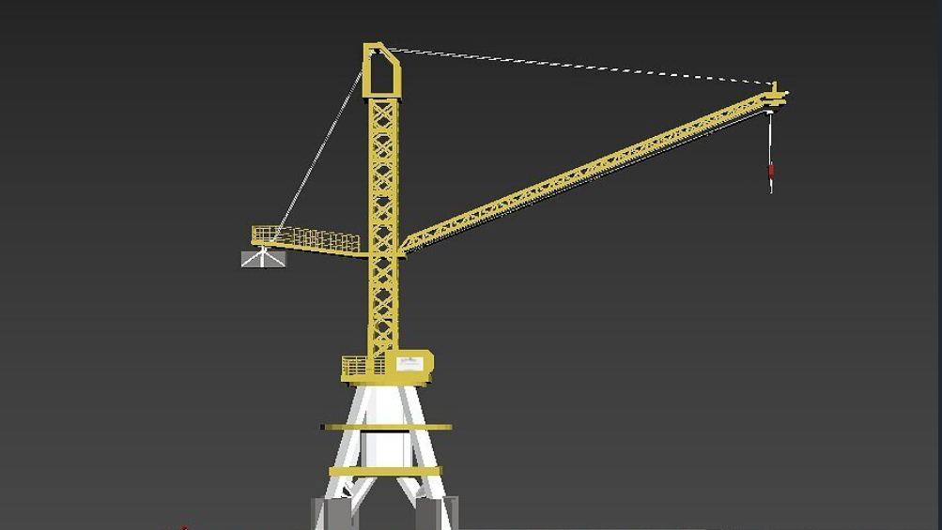

Slide 14
import numpy as np
import scipy.integrate as integrate
# Crane dynamics model (simplified)
def crane_dynamics(t, y, u):
# ... (differential equations)
return dy
# Adaptive control algorithm (e.g., MRAC)
def adaptive_control(y, y_ref):
# ... (update control gains)
return u
# Simulation loop
def simulate():
t_span = [0, 10]
y0 = [0, 0, 0] # Initial conditions
u = 0
sol = integrate.solve_ivp(crane_dynamics, t_span, y0, args=(u,))
# ... (process simulation results, update control gains)
# Main function
if __name__ == "__main__":
simulate()

Slide 15
Conclusion:
Model-free adaptive control has emerged as a promising approach to control systems, offering several advantages over traditional model-based methods. By leveraging input-output data directly, these controllers can adapt to changing environments without the need for explicit plant models.
Key benefits of model-free adaptive control include:
1.Reduced reliance on modeling: Eliminates the time-consuming and often challenging process of developing accurate plant models.
2.Enhanced adaptability: Can handle nonlinearities, uncertainties, and disturbances in the system.
3.Improved performance: Often achieves comparable or superior performance to model-based controllers.
4.Simplified implementation: Can be implemented with fewer tuning parameters and less complexity.
While model-free adaptive control has shown great potential, there are still areas for further research.
These include:
1.Stability analysis: Developing rigorous stability guarantees for a wider range of applications.
2.Performance limitations: Understanding the limitations of model-free controllers in terms of achievable performance.
3.Computational efficiency: Improving the computational efficiency of model-free algorithms for real-time applications.
Overall, model-free adaptive control represents a valuable tool for control system design, offering a flexible and robust approach to handling complex and dynamic systems. As research continues to advance, we can expect to see even greater adoption of these methods in various industrial and engineering domains

Slide 16
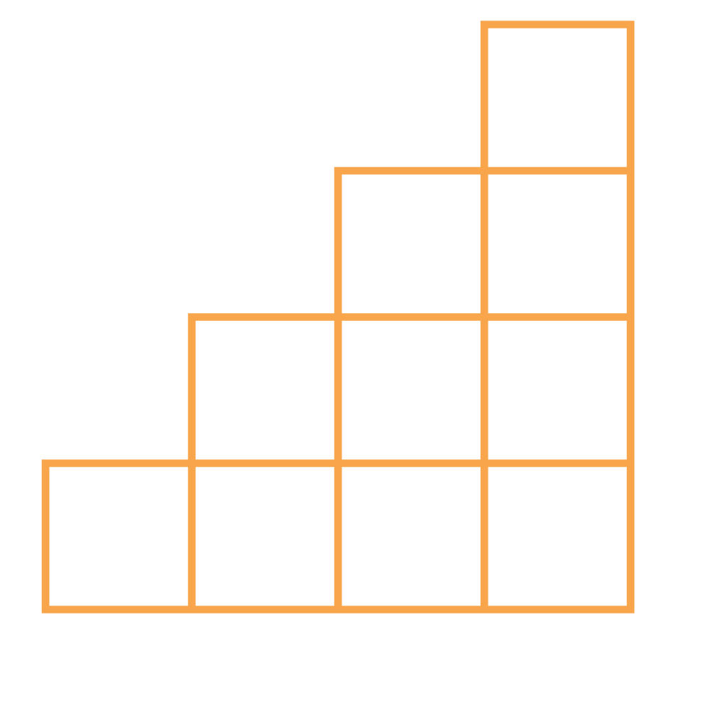
THANK YOU

